Slide 1
INSULINK
A useful diary for your diabetes

Slide 2


OUR TEAM
Nicola Dean
Marco Fasanella
Polimi
C.P. 10674826
Polimi
C.P. 10617541

Slide 3
OUR IDEA
InsuLink main goal is to give a first support to the patient but only if combined with the doctor supervision.
It is important to underline that this application is only defined by an algorithm, and in this kind of diseases each patient needs ad hoc treatments

Slide 4
MARKET SIZE
95%
5%
422 Million
Type 2
Type 1
People worldwide suffer Diabetes
Source: WHO

Slide 5
Functionalities
Scan your food
Insulin Calculator
Scan a given Food BarCode and read all its nutrients!
An algorithm will retrieve all essential data to calculate the optimal insulin dose
Calendar
Glycemia
Users can see a well detailed sight of all previous data, just choosing a date from the InsuLink calendar
Keep track of your daily Glycemia with intuitive charts!

Slide 6
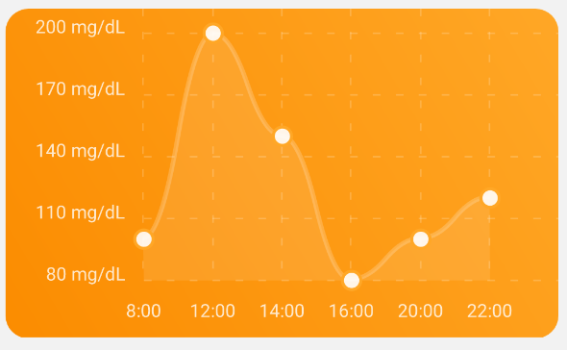
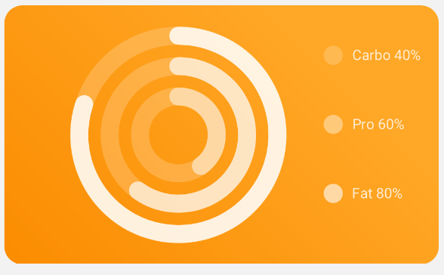
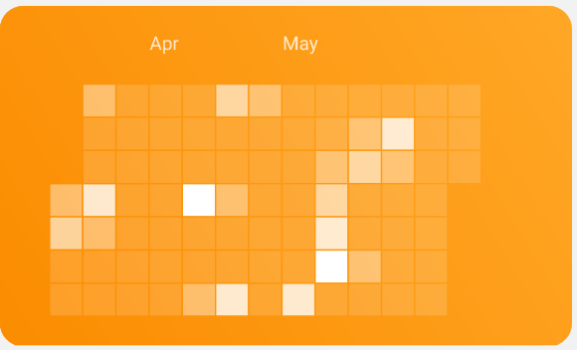
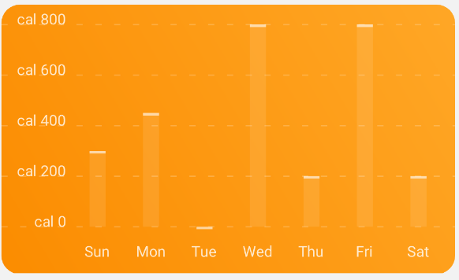
Charts
Glycemia Trend
Macro
Sport HeatMap
Sport last week

Slide 7
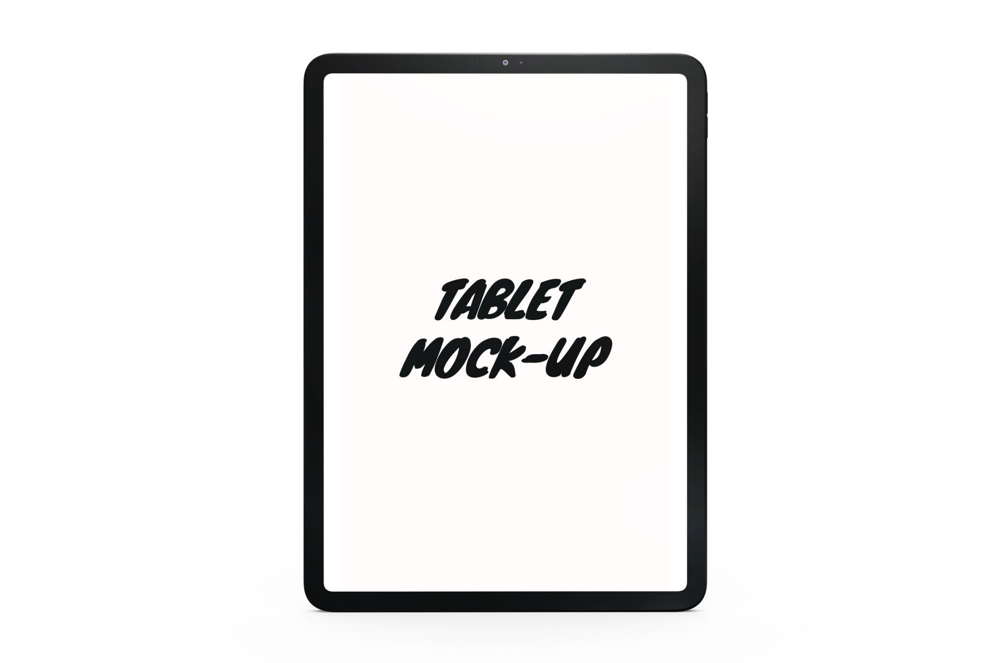
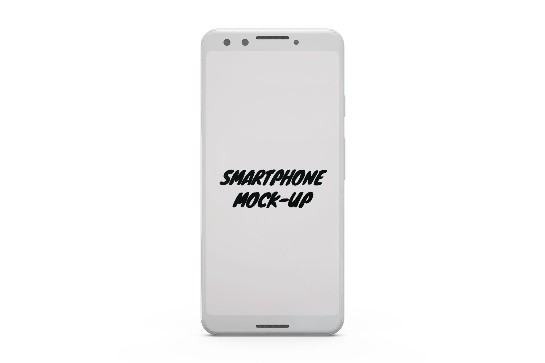
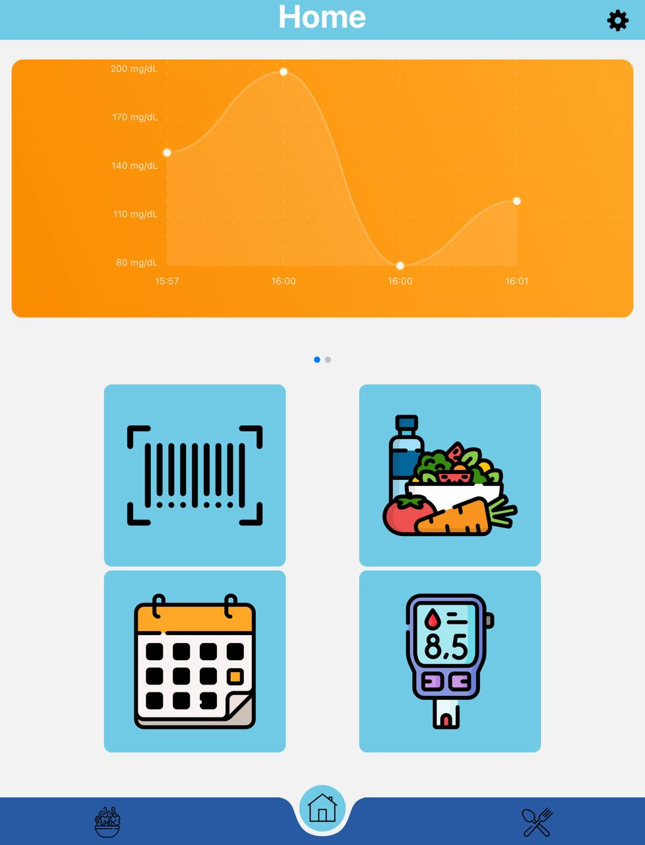
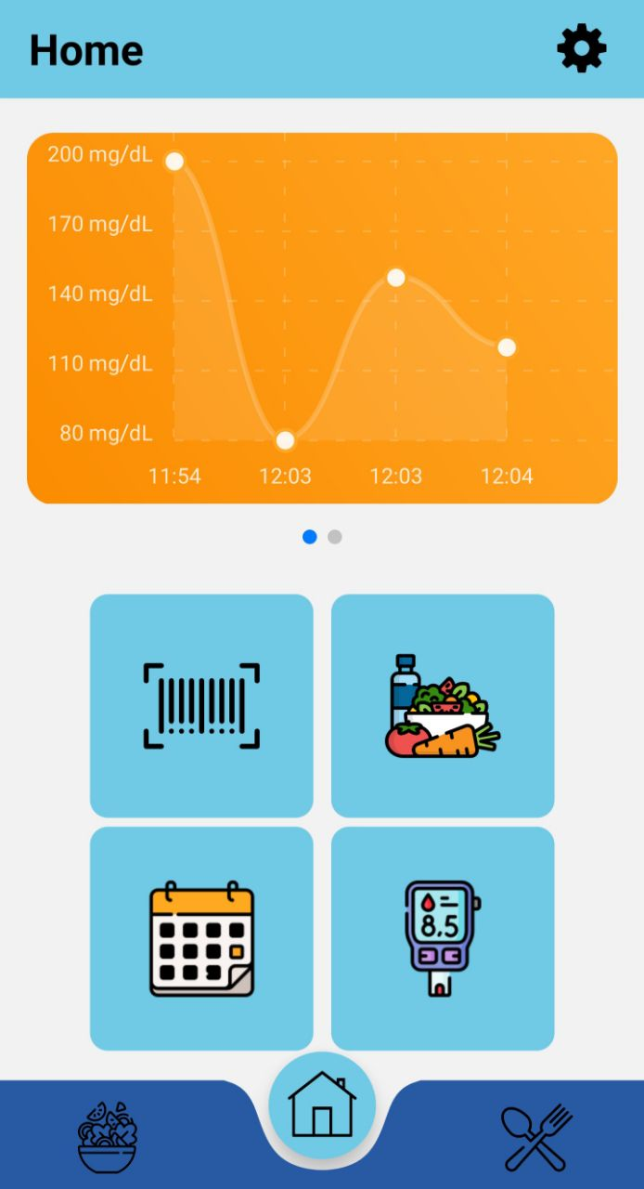
Layout
iPad
Phone
Dynamic adaption for tablets. Currently tested on iPad
Compact style with both Android and iOS devices supported

Slide 8
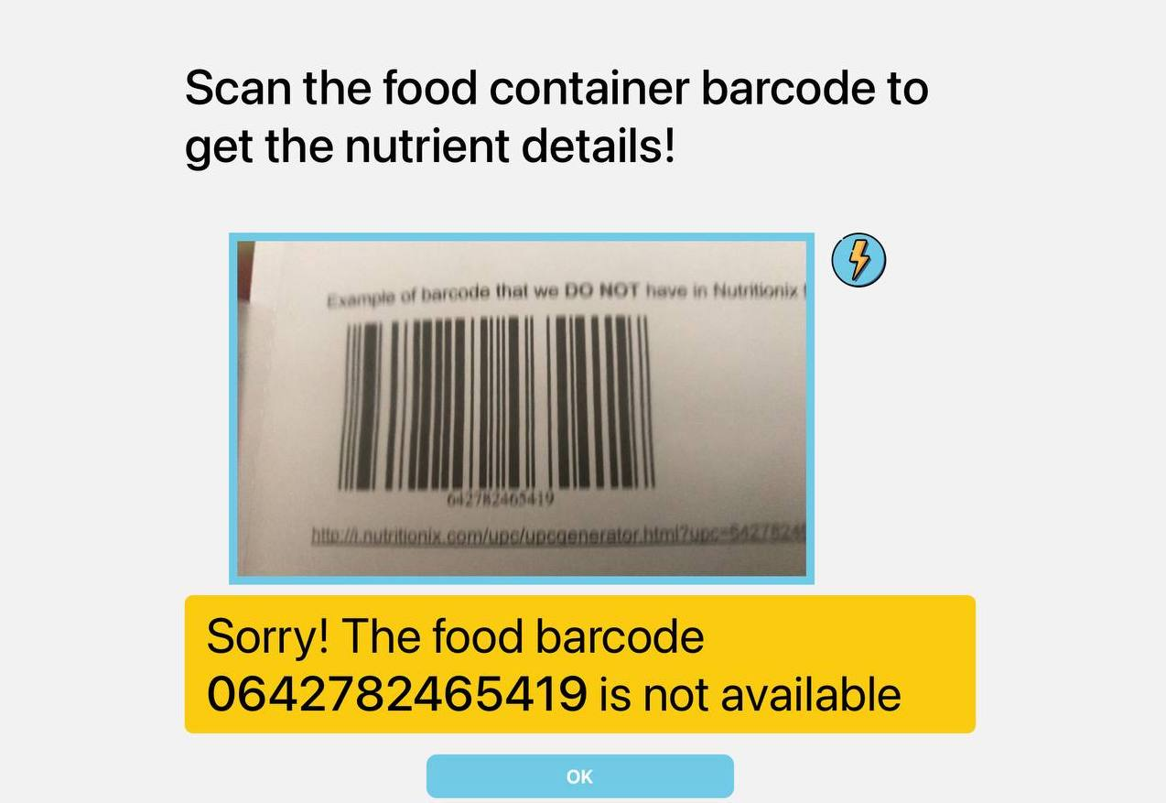
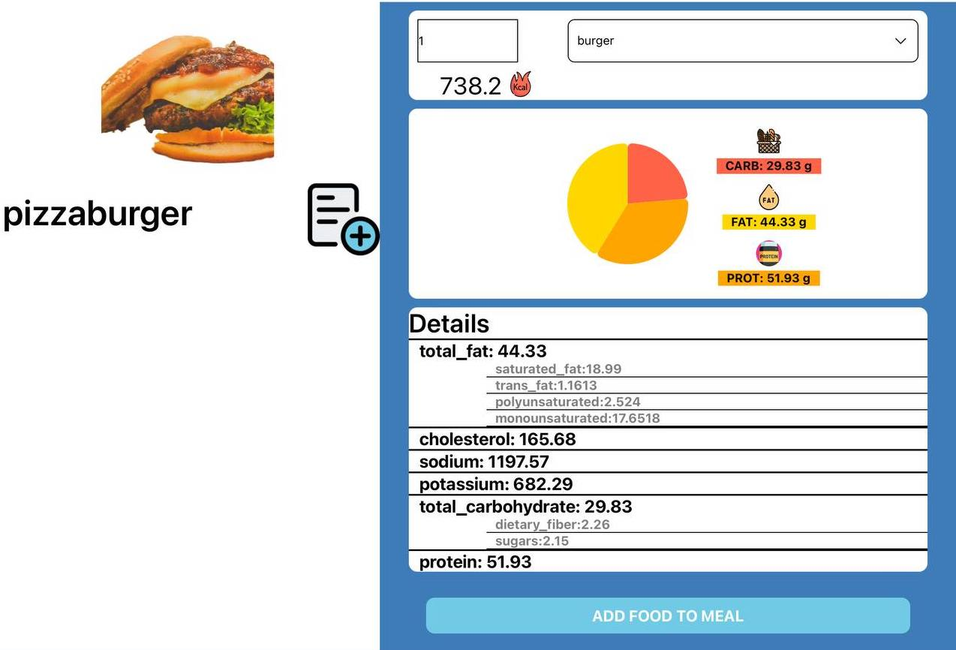
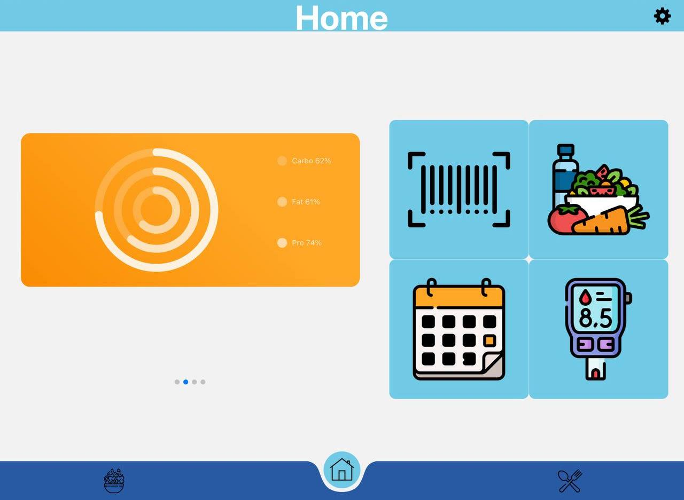
Horizontal Layout
Tablet
iPad and Tablet support also customized horizontal layout

Slide 9
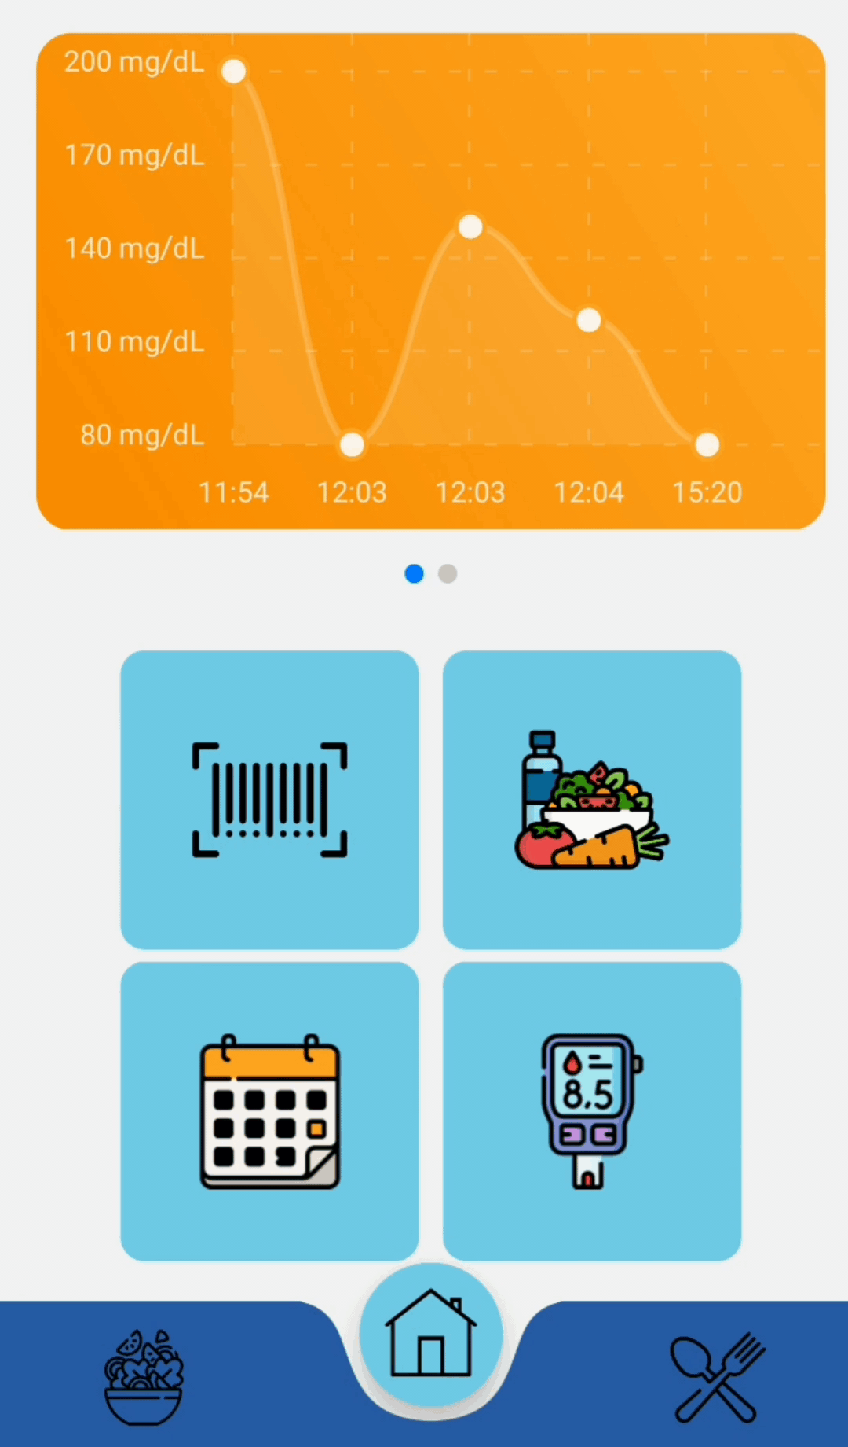
Demo
Charts
Useful charts with glycemia Trend and macros
Shortcuts
Just click a button to reach all the functionalities
Navigation
Instantly navigate from home menu to the diary or food search

Slide 10
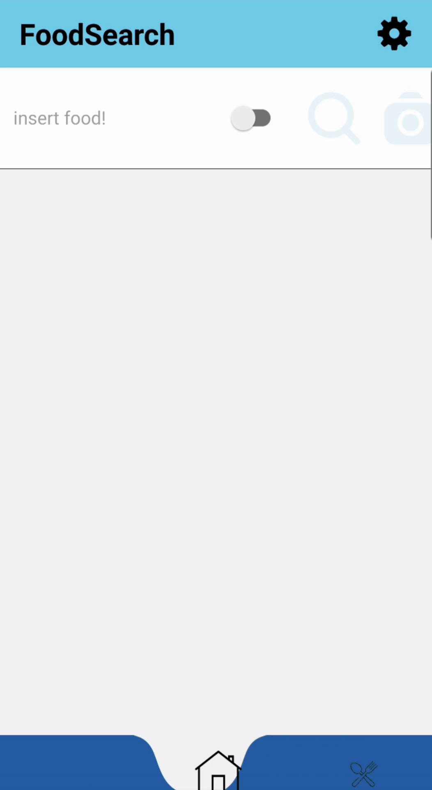
Search
Go in detail
Search every kind of food or recipe and get all nutrition details you need

Slide 11
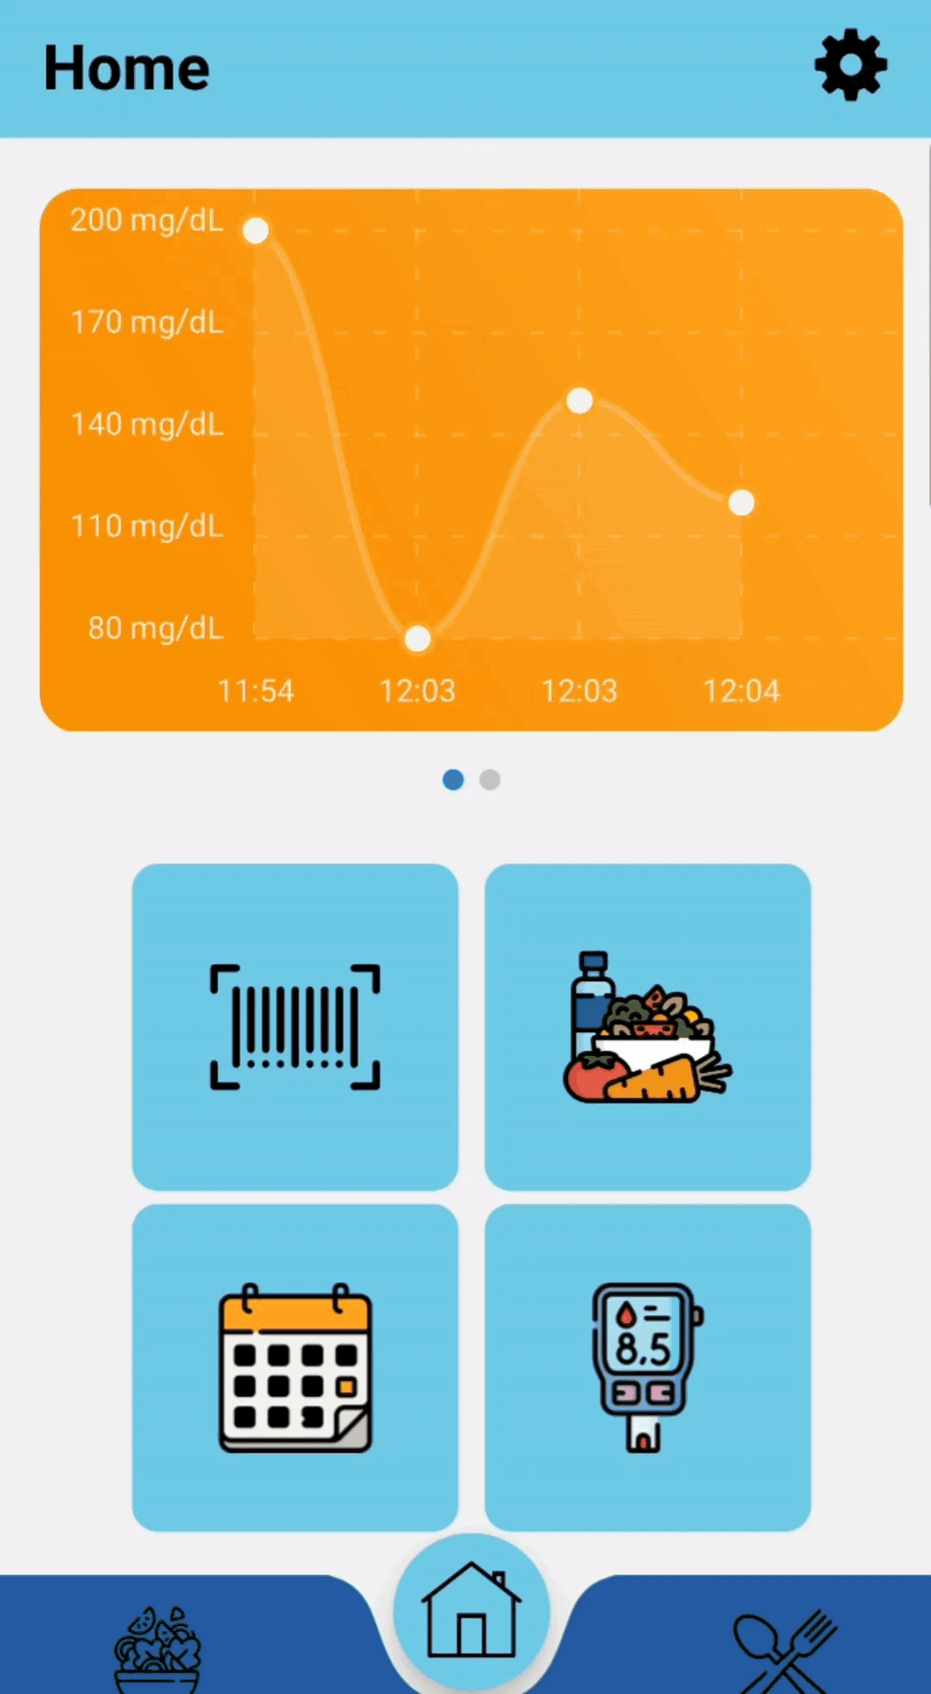
Scan
API
Moreover, using Premium APIs the
Barcode
Most Famous Food is available for scan

Slide 12
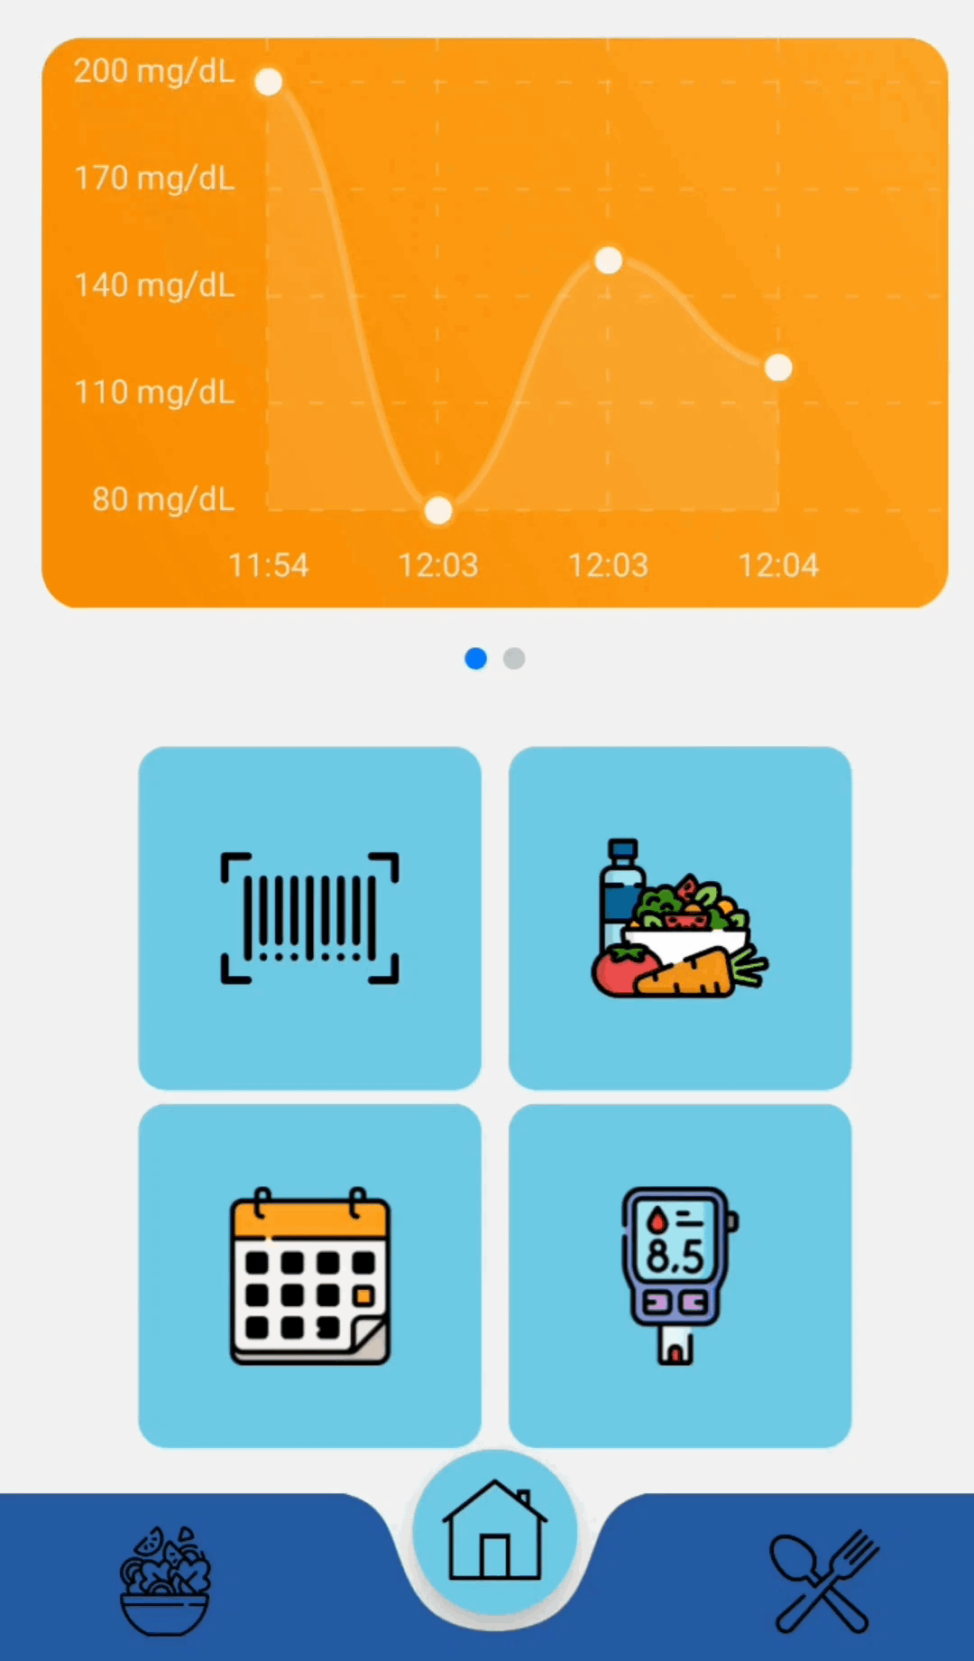
Glycemia
Misuration
Save your current glycemia and see its trend

Slide 13
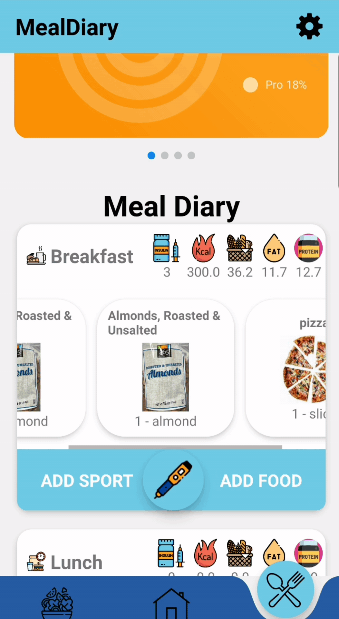
Insulin Calculator
Skip
Last Glycemia
Last Glycemia value is used
Insert you last misuration

Slide 14
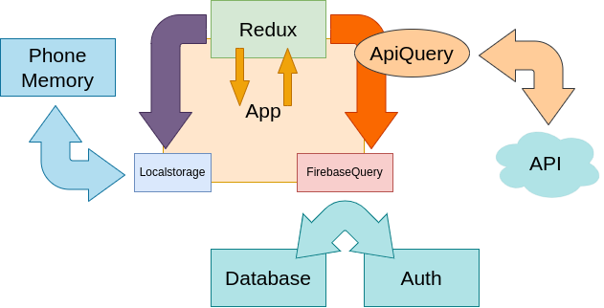

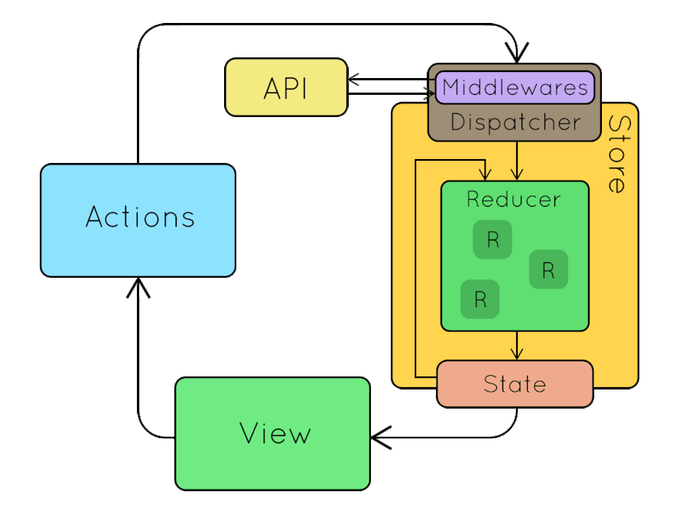
Architecture

Slide 15
TEST STRATEGY
Check change in status or pages aspect
Snapshot
Test Pages/Components buttons events
Widget
Unit
Test our helper class methods individually

Slide 16
TEST STRATEGY
16
Test suites
59
Normal Tests
33
Snapshots

Slide 17
Testing
Firebase
Api
Check Firebase components are called correctly
Check api queries
Localstorage
Redux Reducers
Check Local storage function use data correctly
Snapshot reducers behaviour

Slide 18
Testing
InputChecker
Components
Check Login/Reg errors are thrown correctly
Snapshot custom buttons
components
Pages Snapshots
Pages WidgetTest
Snapshots on the page base aspect
Test pages buttons/inputs behaviour

Slide 19
Future Implementations
Some improvements that will make InsuLink even more faster and accurate!

Slide 20

Machine Learning
NFC Technology
Useful to predict the correct insulin dose
Measure your glucose directly from the App
Premium API
Find even more food and recipes

Slide 21
THANKS
Special thanks to Matteo Ciancio who designed the app logo. For any business contact you can reach him at: matteociancio99@gmail.com

